Slide 1


Investigation of
OffensEval2019:
Identifying Offensive Language
in Social Media
Team name: Chinaysia
Team members:
Zhanyang Liao (201307901)
Noor Fatin Atikah Norazman (201293154)
Shuyue Jiang (201271995)
Zhaohui Geng (201295668)
Liting Gai (201307334)

Slide 2
Evaluation
Modelling
Data preparation
Data understanding
Business understanding
Notes:
All of the steps done in this process followed the framework of the Cross-Industry Standard Process for Data Mining (CRISP-DM). CRISP-DM is a result of an effort funded by the European Community to develop a standard framework for data mining and text mining tasks.
However, we only took the first five steps of the framework for this project.
Which is the business understanding, data understanding, data preparation, modelling and lastly evaluation.
*In general, there are five main steps in this framework.
*Starting with understanding the project objective and requirements for the business and the business problem that we would like to solve.
*Next, It times to start to get familiar and understand the data available and how do we use it to solve the identified business problem.
*Then, we will start to prepare the data for further analysis.
*When the data is ready and properly cleaned we will begin the modeling part.
*Lastly, when the modeling part is done, we will evaluate which model is the most suitable and gives the best results to achieve the desired objective.
*If you notice there is another one last step in the framework of crisp-dm which is deployment.
*However, as for this project, we will go from the very first step of the framework which is business understanding up until the evaluation stage only.

Slide 3
Business Understanding
Business objectives and requirements
Identifying and categorizing offensive language in social media in order to reduce the appearance of offensive text.
Problem definition
Offensive language is pervasive in social media. Individuals frequently take advantage of the perceived anonymity of computer-mediated communication.
“Identify offensive sentences and words and classify them into different categories”
Notes:
The objective of this task is to identify and categorize offensive languages in social media to reduce the appearance of offensive text.
Nowadays, the use of offensive languages is pervasive all over the net, especially in social media. Individuals frequently take advantage of the perceived anonymity of computer-mediated communication to wrote or post anything they want including offensive things.
Hence, come to this realization we would like to identify offensive sentences and words and classify them into different categories.

Slide 4
Data understanding
subtask_a
OFF
NOT
Source: Provided on Minerva olid-training-v1.0.tsv
id | tweet | subtask_a | subtask_b | subtask_c
int | string | string | string | string
subtask_b
UNT
TIN
id | Number of each comment
tweet | Tweet comments by users
subtask_a | Offensive language identification
subtask_b | Automatic categorization of offense types
subtask_c | Offense target identification
subtask_c
IND
OTH
GRP
Notes:
Now I am going to talk about the dataset of this project.
The original datasets come with five attributes that you can refer to from the first box above.
The first attribute or column is an id column which represent unique number for each tweets.
The next column is a colum called tweet which represent the data of the real tweet that wrote by the users.
The third, forth and fifth column are called subtask_a, subtask_b, and subtask_respectively. These three column are target variables that contains nominal categories of data.
Subtask a is the column for offensive language identification, subtask b is the column that gives information about an automatic categorization of offense types and subtask c is for the offense target identification.
We will go further down about these three target variable in the next two pages.

Slide 5
subtask_a | Offensive or not
OFF | A post contains offensive language or a targeted offense.
NOT | A post does not contain offense or profanity.
subtask_b | Offense types
UNT | A post contains non-targeted profanity and swearing.
TIN | A post contains an insult or a threat to an individual, group, or others.
subtask_c | Offense target
IND | an individual
GRP | a group of people
OTH | not belong to any of IND or GRP
Notes:
Please click the button 2 to play the second audio after the first audio is finished automatically!!
In this page, I will elaborate more on the three target variables from the datasets.
The first one is a variable named subtask a. This variable contains nominal data which represent by three input categories which are OFF that stands for an offensive tweet, NOT which stands for a not offensive tweet and lastly null which means there is no data for that tweet whether it is offensive or not.
Secondly, the variable named subtask b. Just like subtasks a this variable also contains nominal data and represent by three input categories. One of them is UNT which represents that the offensive tweet contains non-targeted profanity and swearing, other than that is TIN which represents that the offensive tweet contains insult or a threat to a targeted individual or group.
The third one is a variable called subtask c which categorized whether the offense target is for individual, group or other target types.

Slide 6
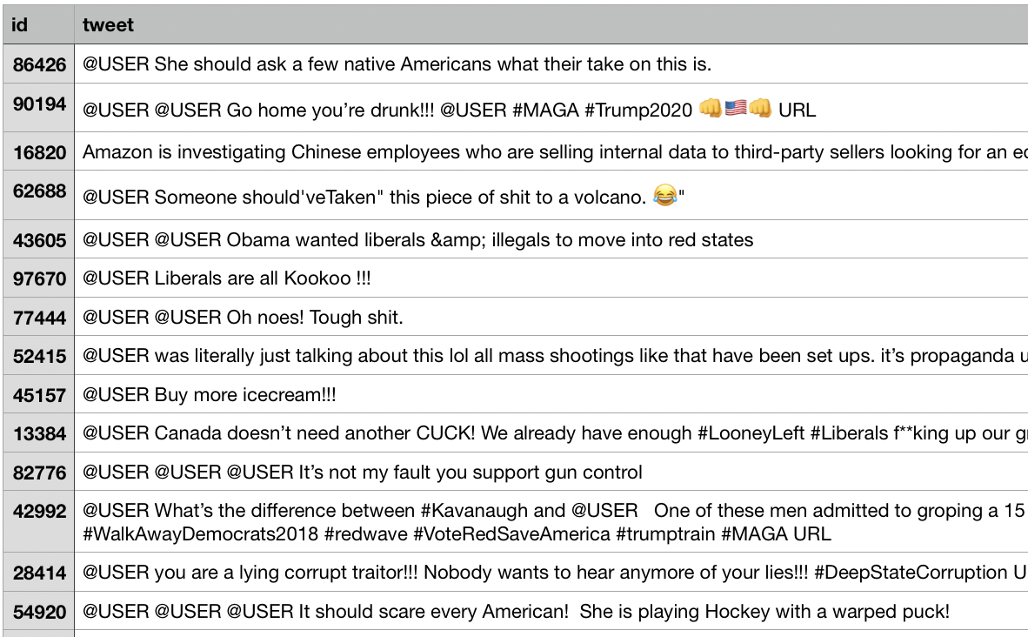
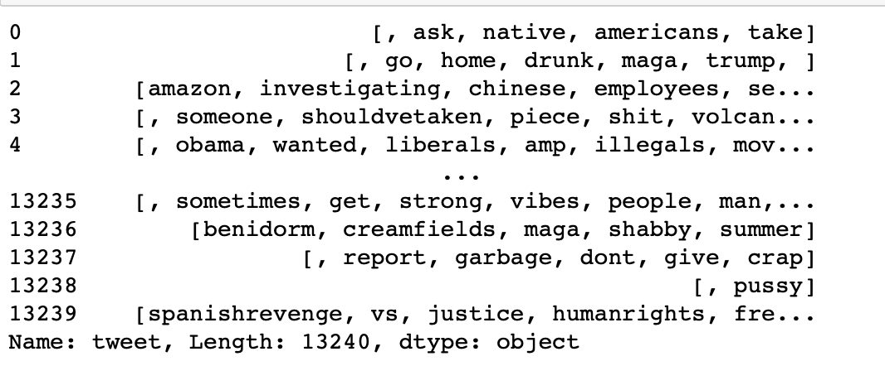
Expected results
Data quality
Notes:
Now I am going to explain about the data quality of the original dataset.
The top box is the original data that we get, and below is the kind of dataset that we plan to have for further analysis.
As you can see from the original datasets, it contains quite a lot of noises that we do not want such as emojis, hashtag, and a few words with aliases. We plan to come out with the dataset as the below box, which definitely will be better for further analysis.
However, a lot of effort needs to be done beforehand.

Slide 7
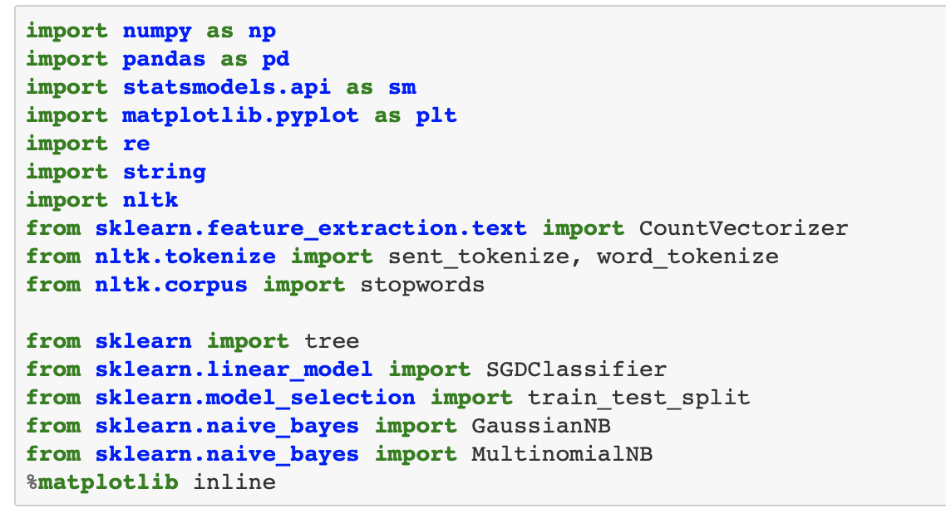
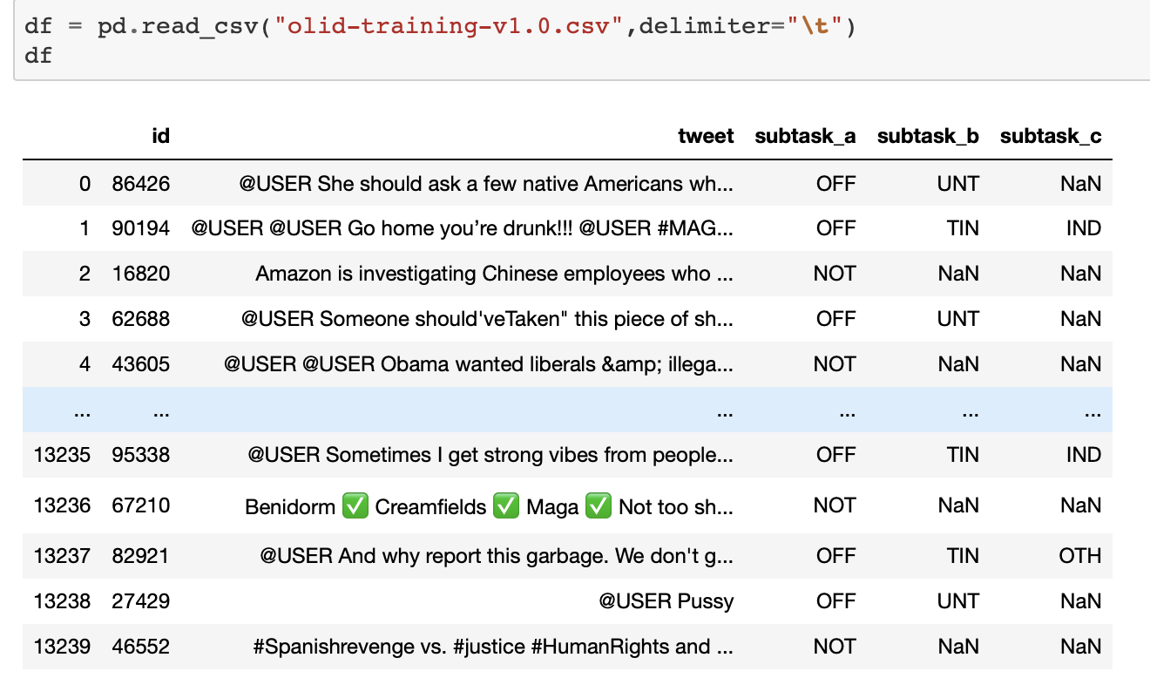
Data preparation
Mining tool: Python
Notes:
Next, we move to the data preparation process, *which I just mentioned that this is where a lot of effort required.
The main mining tool that we use is python programming which we found as the most convenient tool to use *which provides a lot of free source packages and dictionaries.
*The screenshot shown how is the original data look like on jupyter notebook interface.

Slide 8
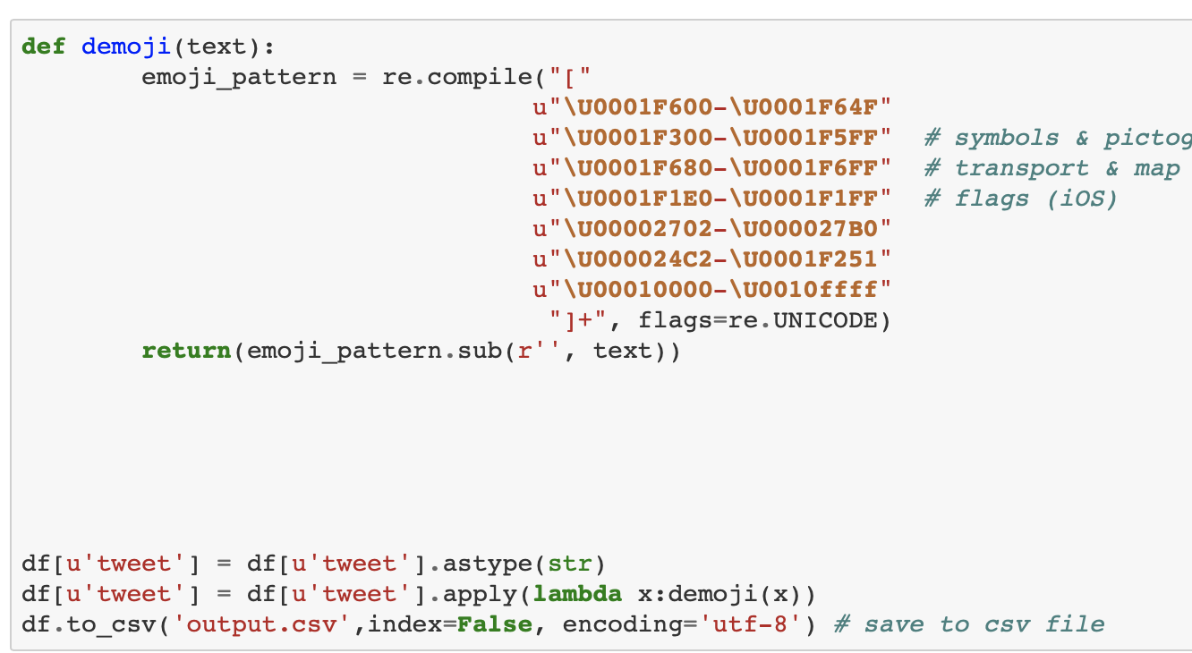
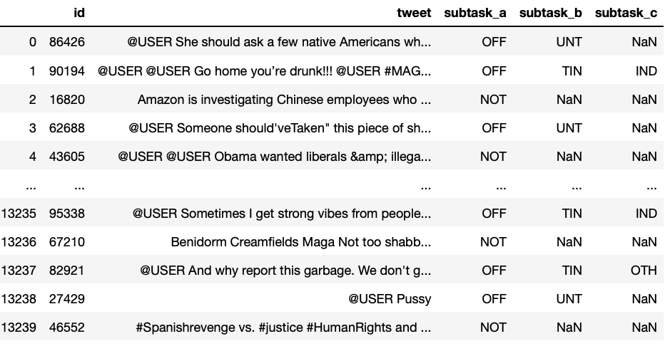
😂
Remove emoji
Notes:
The first thing we do is run a code to removes all the emojis in the tweet by using a function that we created called Demoji().

Slide 9
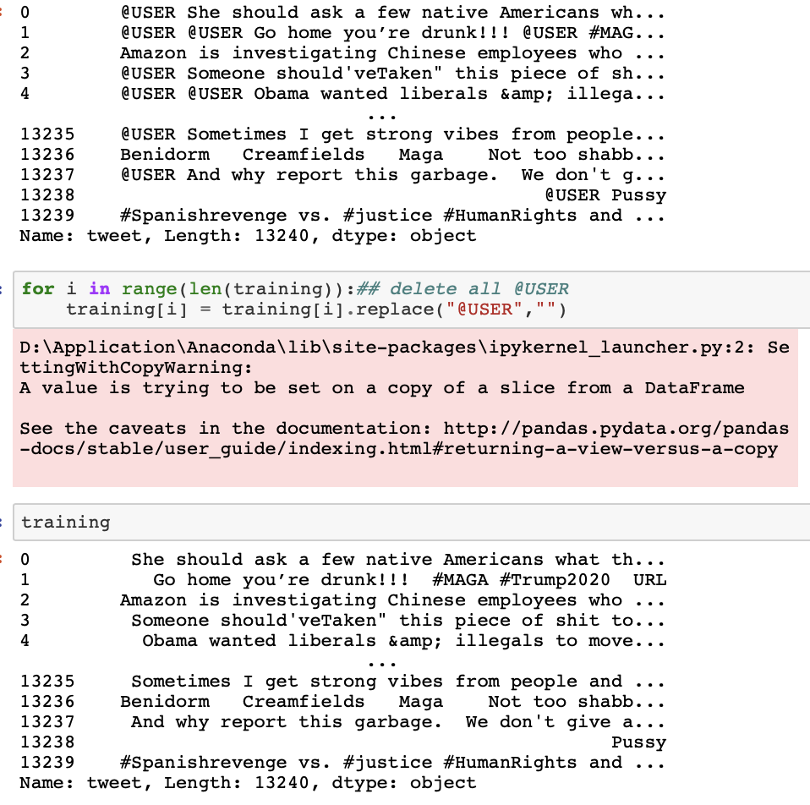
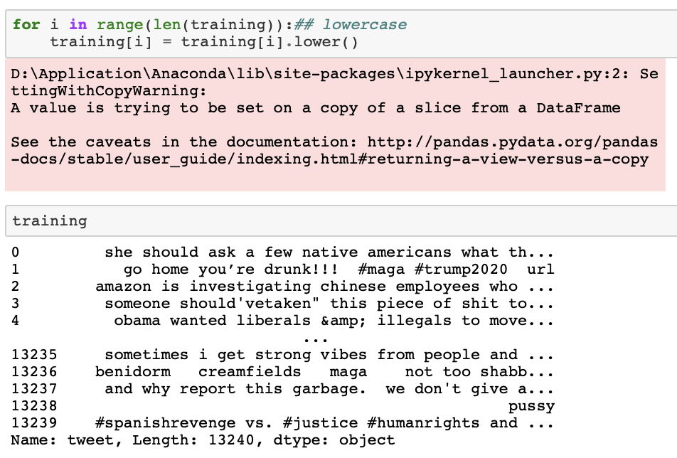
Delete @USER
Uppercase to lowercase
Notes:
The steps then continued by deleting user words with an alias on the initial. After doing that, we convert all of the letters into lowercase.

Slide 10
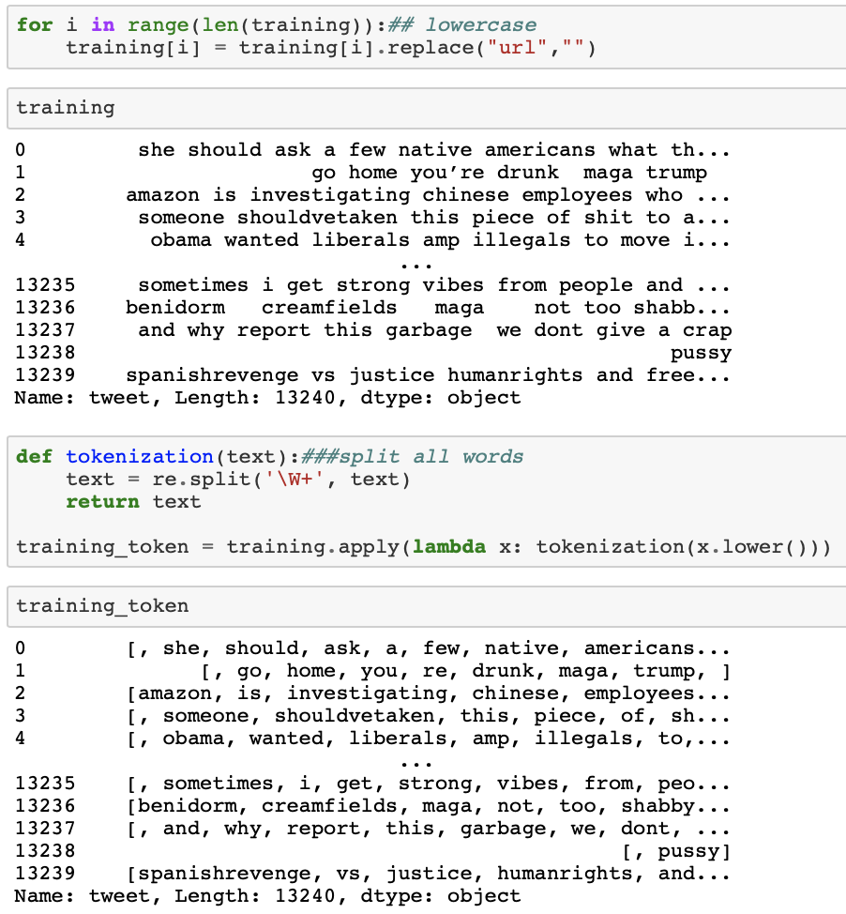
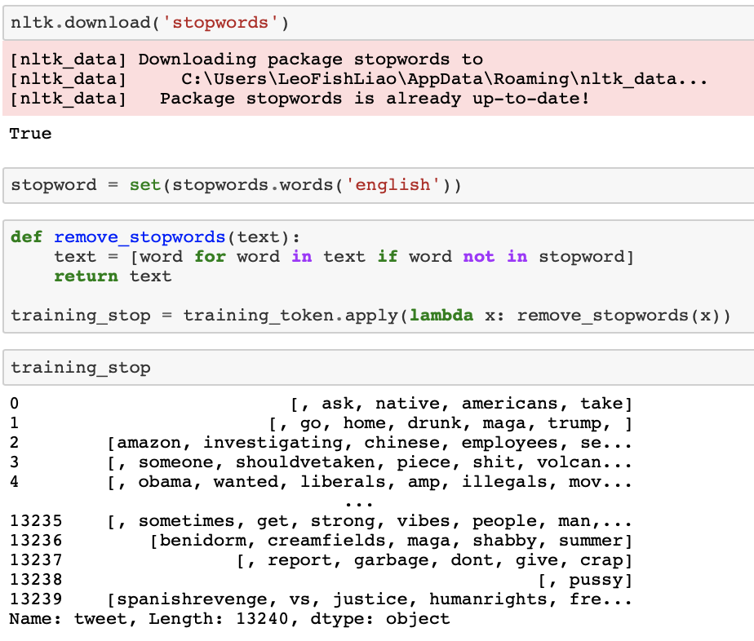
Delete URL
Delete stopwords
'i', 'me', 'my', 'myself', 'we', 'our', 'ours', 'ourselves', 'you', "you're", "you've’…
Split words
Notes:
Then, we remove all the URLs and the stopwords that exist in the tweet.
In a layman term, "stop words" usually refers to the most common words in a language such as a the, I, me, myself, etc. These kinds of words are a very common word that does not give any strong meaning for our case of detecting offensive language. There is a total of 179 stopwords in the stop words dictionary that we use.

Slide 11
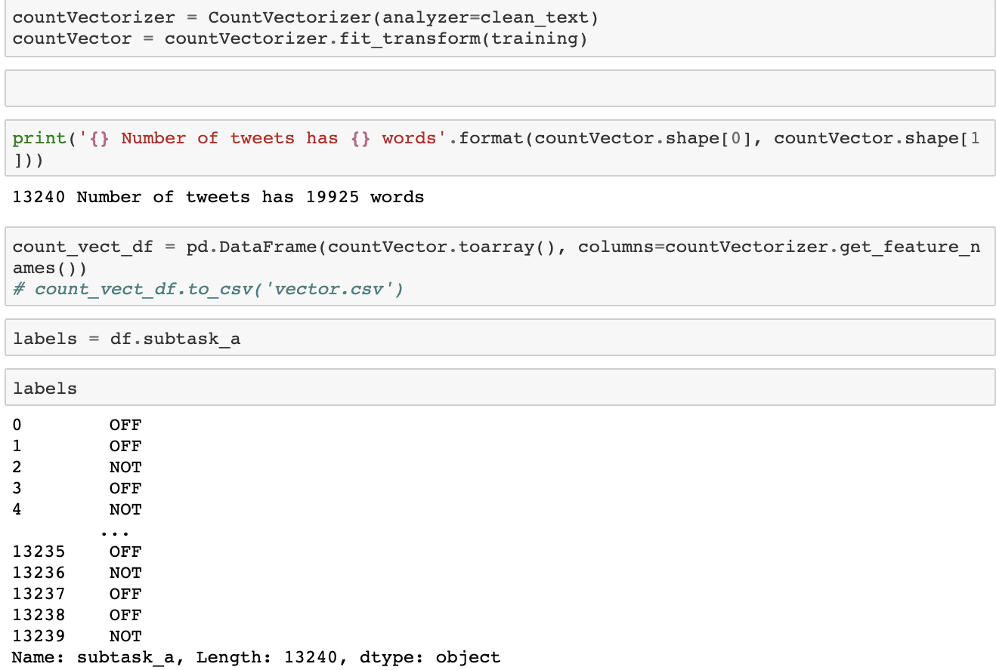
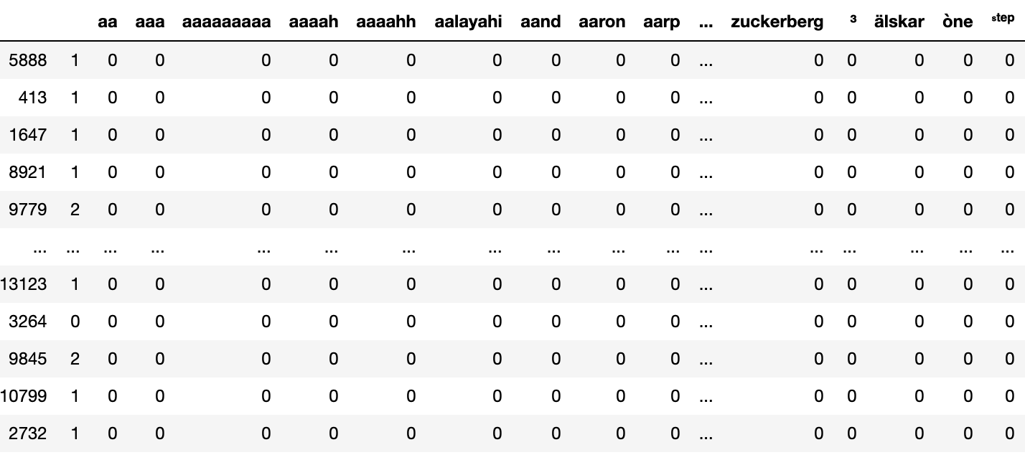
Vectorization
Notes:
The final touch before we start with the modeling part is vectorizing all those words in the datasets. This vector will then be used in the classifier algorithm to predict the offensiveness of a tweet.

Slide 12
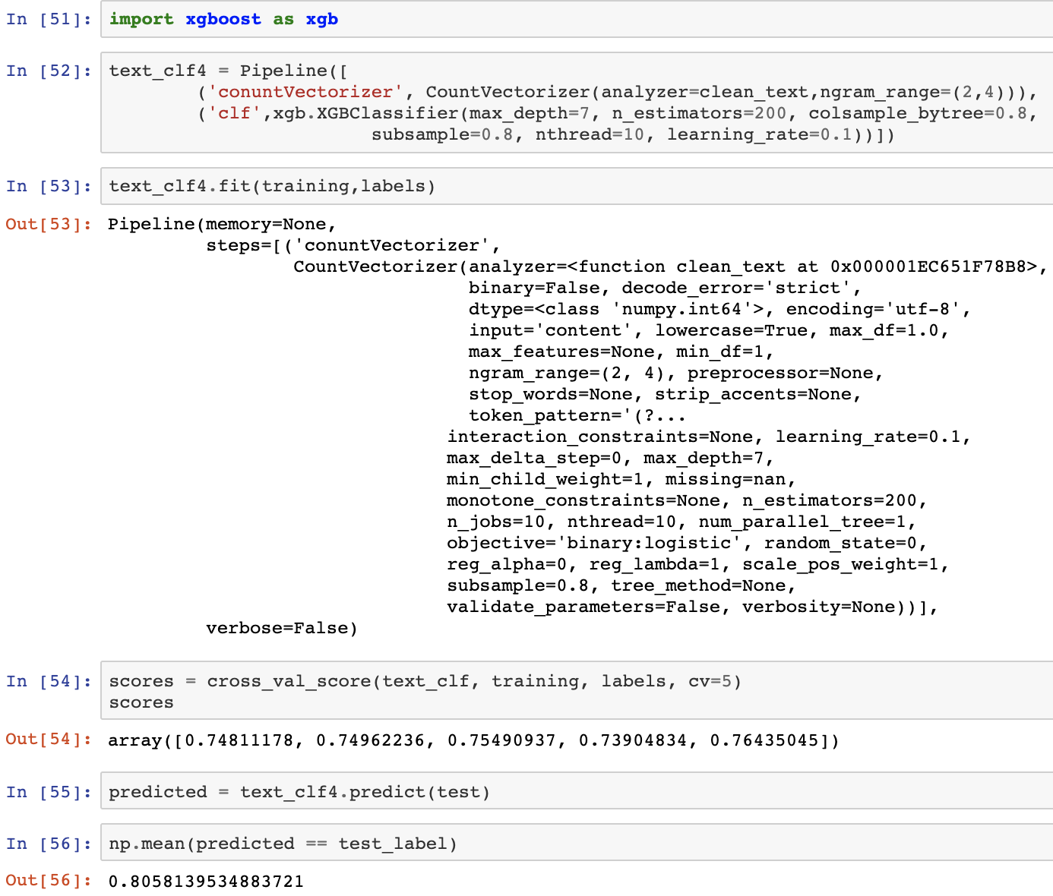
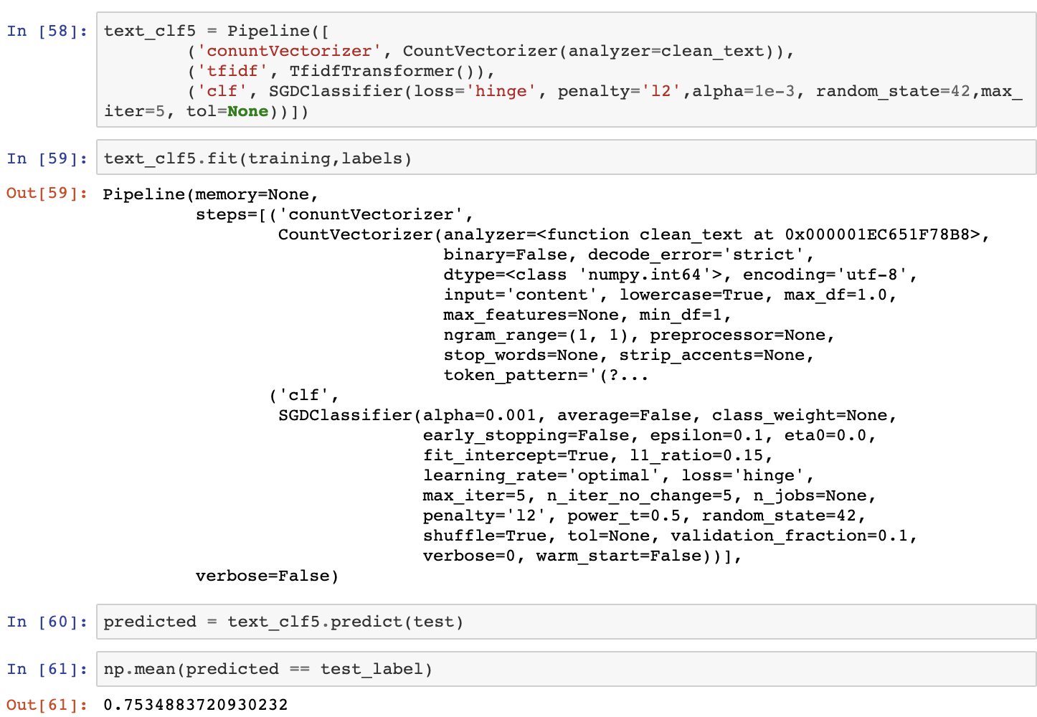
Modelling (Task A)
Xgboost
SGD
Notes:
Now we move to the most exciting part of the project which is the modeling part.
Starting with modeling for subtask, in general, we have used five types of modeling for these steps.
All of the modeling tasks have been done by using python packages.
This page shows two out of five classifiers that we use which is XGBoost and SGD which stands for Stochastics Gradient Descent.
*XGBoost is an implementation of gradient boosted decision trees designed for speed and performance.
*On the other hand, Stochastic gradient descent is an iterative method for optimizing an objective function with suitable smoothness properties.

Slide 13
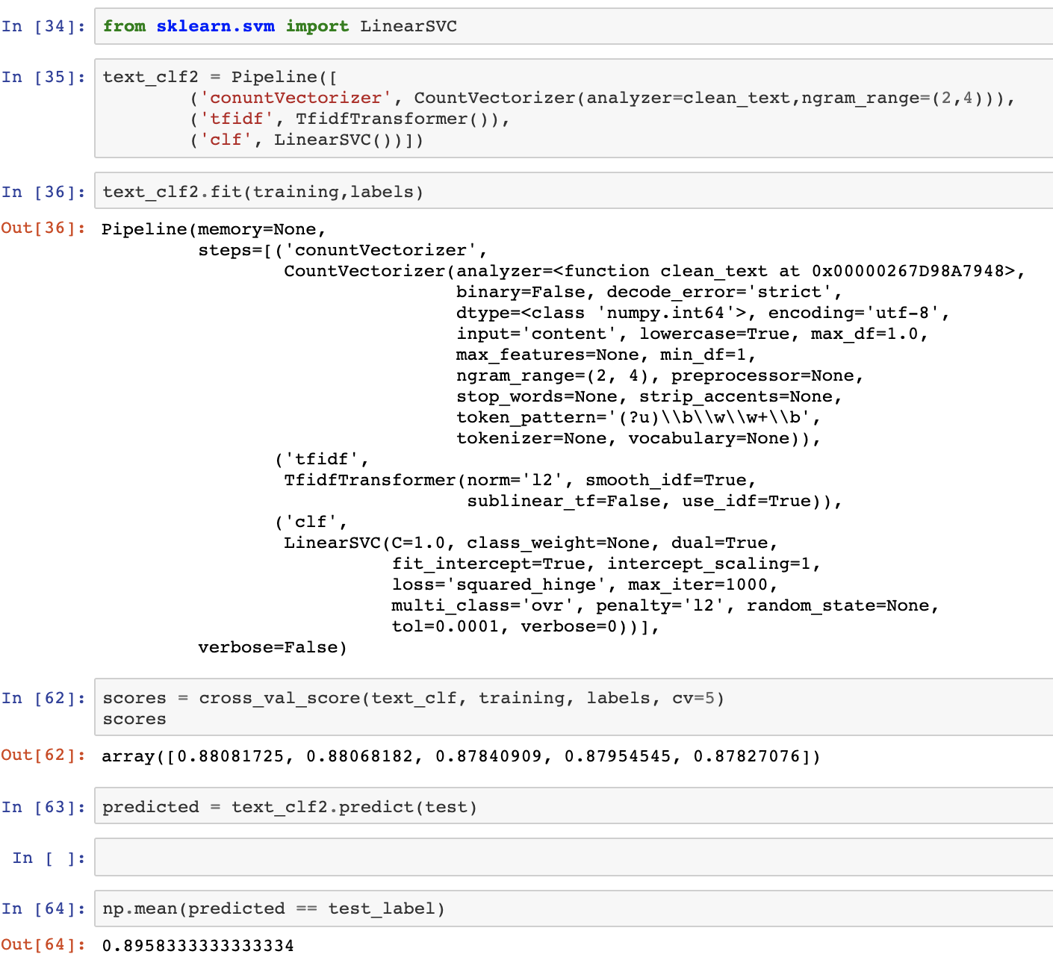
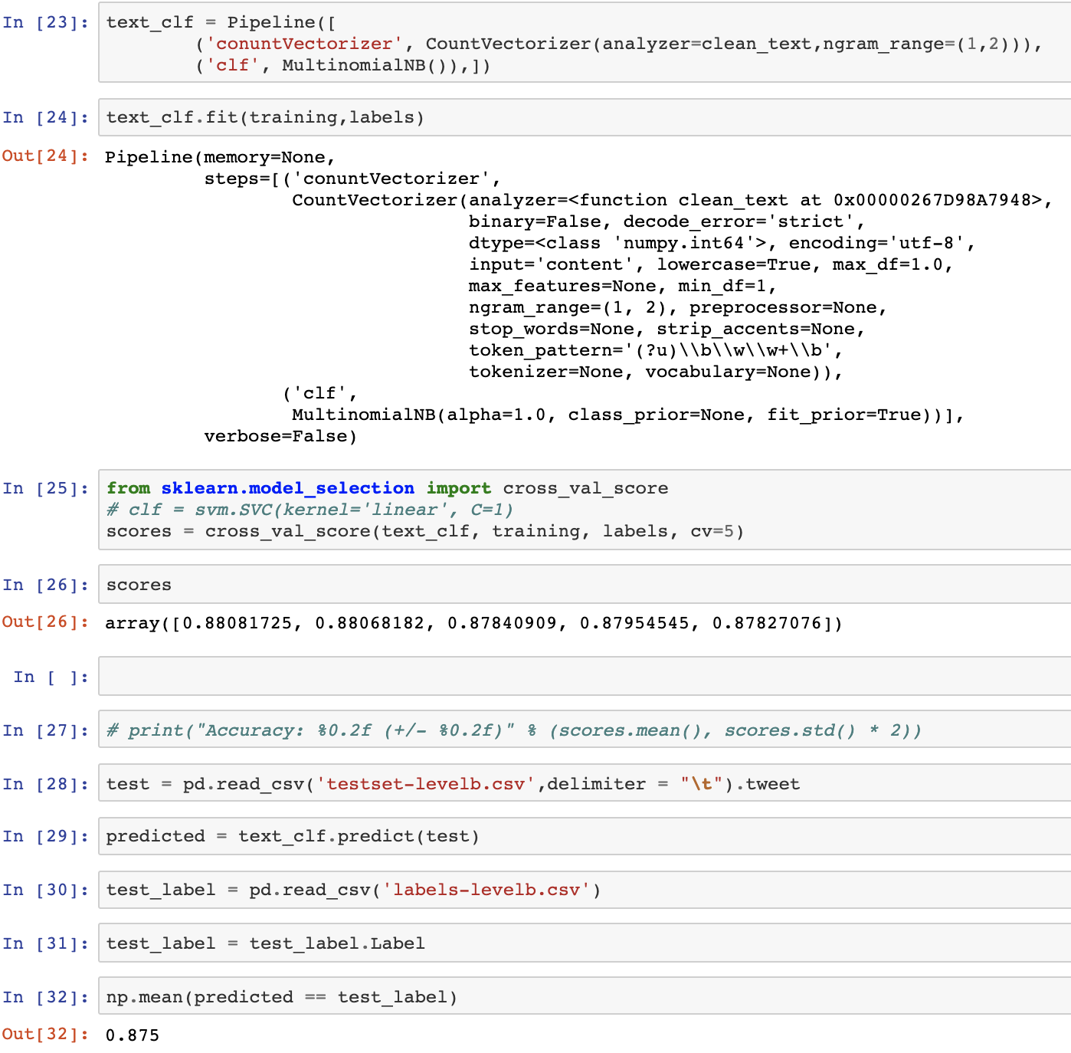
Modelling (Task B)
Support Vector Machine
Naïve Bayes
Notes:
And after that, we reused all of the five classifiers for subtask B and the slide shows another two of the classifier which is Support Vector Machine and Naïve Bayes.
*The main idea of Support Vector Machine is the algorithm creates a line or a hyperplane which separates the data into classes.
*As for Naïve Bayes, it predicts membership probabilities for each class such as the probability that a given record or data point belongs to a particular class.

Slide 14
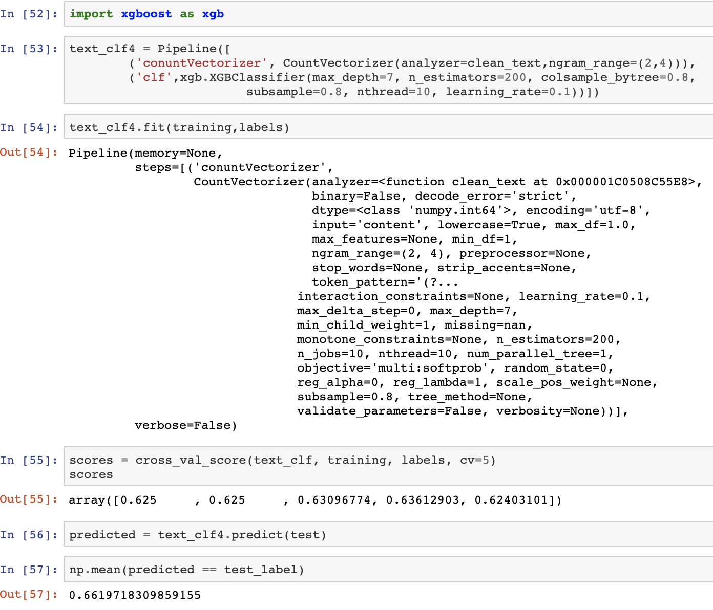
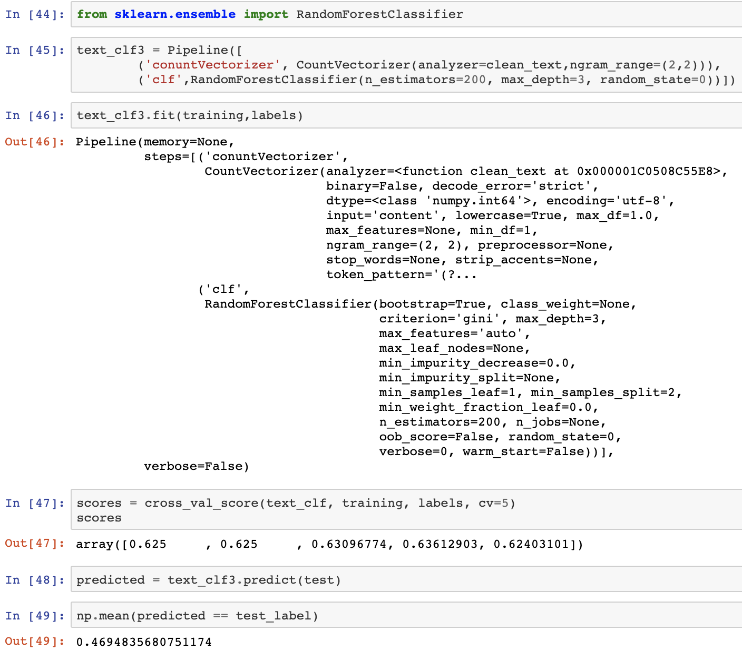
Modelling (Task C)
Xgboost
RandomForest
Notes:
The same goes for subtask C, we run the same five classifiers for this task.
The last one out of five classifiers that have not mentioned is Random Forest.
*Random forest is an ensemble learning method for classification, regression and other tasks that operate by constructing a multitude of decision trees at training time and outputting the class that is the mode of the classes (classification) or mean prediction (regression) of the individual trees.
I suggest that you can do further reading on all of the five classifiers that we use for better understanding of the context of how the algorithm for the respective classifiers working.

Slide 15
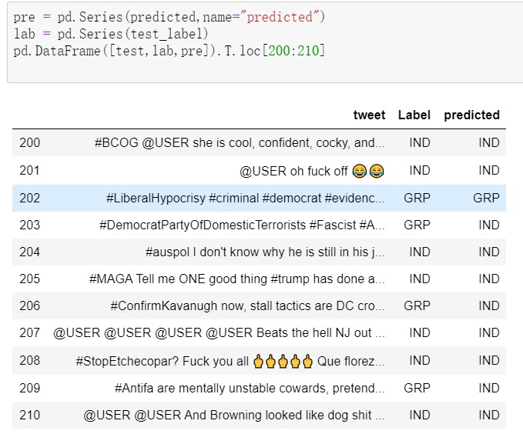
Evaluation
Classifiers | Accuracy of A | Accuracy of B | Accuracy of C
Naïve Bayes | 79.2% | 87.5% | 48.8%
SVM | 78.0% | 89.6% | 61.5%
RandomForest | 72.1% | 88.8% | 46.9%
Xgboost | 80.6% | 89.2% | 65.7%
SGD | 75.3% | 88.8% | 57.7%
https://www.youtube.com/watch?v=qVdciF8e5-s&feature=youtu.be Watch it!
Notes:
Now we come to the evaluation part.
All of the results from the classifier that we tested on the training data set are summarized here.
As you can see, for the first modeling for subtask a, the best classifier for this is Xgboost. This classifier gives 81% level of accuracy which we can consider as a good result.
Moving to the result for subtask b, the highest percentage score is from Support Vector Machine which gives 90% level of accuracy. This a very good result but we might need to check for overfitting just to make sure that the result is reliable.
The last one is the result for subtask c, which the best classifier is the same as subtask a, XGBoost. The percentage result for this are 66%.
For the subtask c, we notice that most of the 34% of misclassification are comes from the data that label as GRP, offense target is a group. It wrongly predict to IND which mean the offense target is an individual. We assume that this is because the learning of the offense target as a group is a bit more complicated thing to do. However, to justify our assumption a further enhance analysis need to be done.

